Slide 1

Made by Amir-Georges Haya

Slide 2
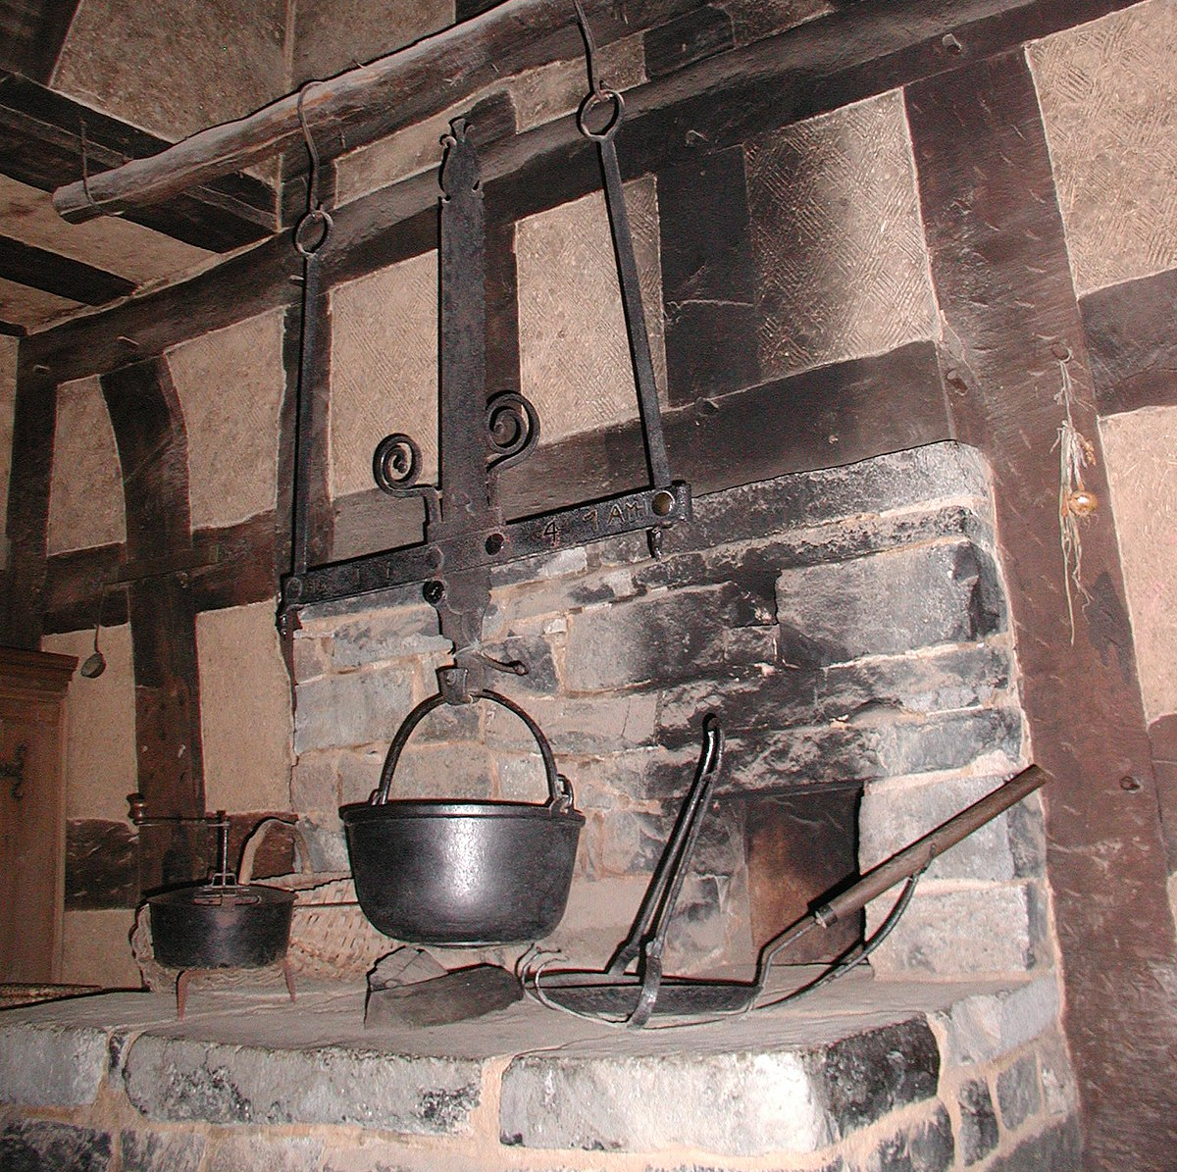
Heaven Hearth: the inspiration
Heaven: Religious cosmological (making sense of the world through religion) where deities, angels, etc live.
Hearth: The place in a home where fire is kept for heating.
Why the name:
Hearth: A fireplace is usually used in literature to describe a warm place (a place that feel comforting).
Heaven: used in literature when something achieves something even higher than content or happiness.
Notes:
https://upload.wikimedia.org/wikipedia/commons/thumb/9/96/RFK-005-Feuerstelle-im-17-Jh.JPG/1200px-RFK-005-Feuerstelle-im-17-Jh.JPG

Slide 3
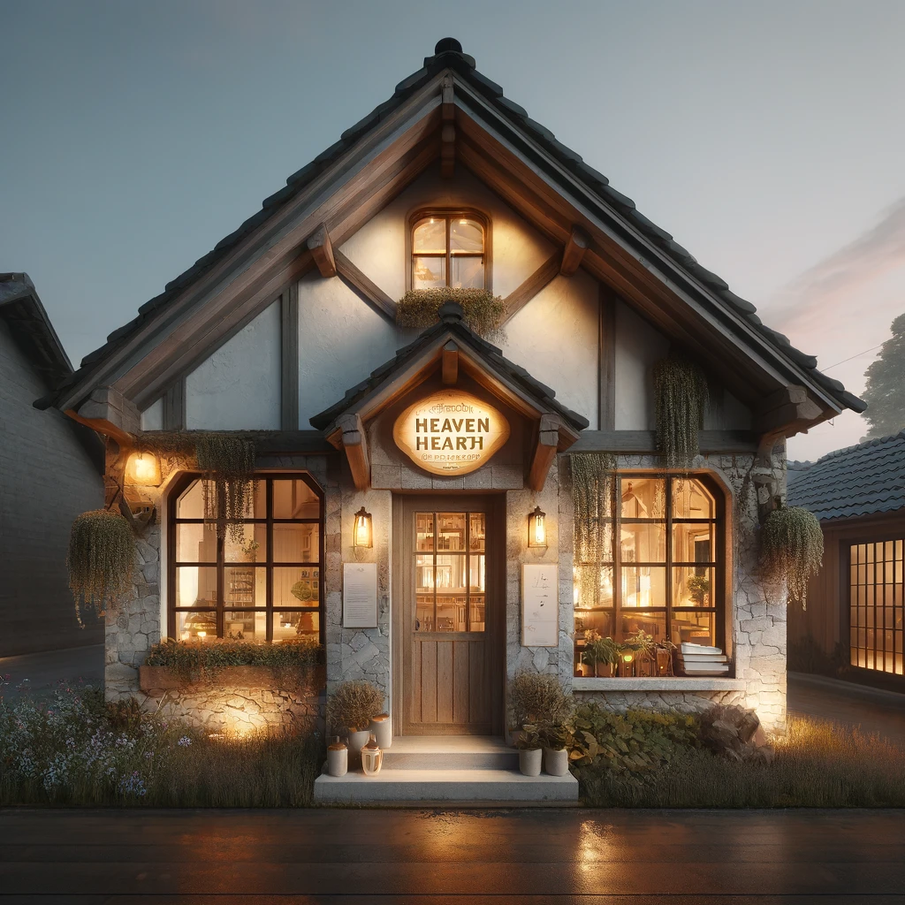
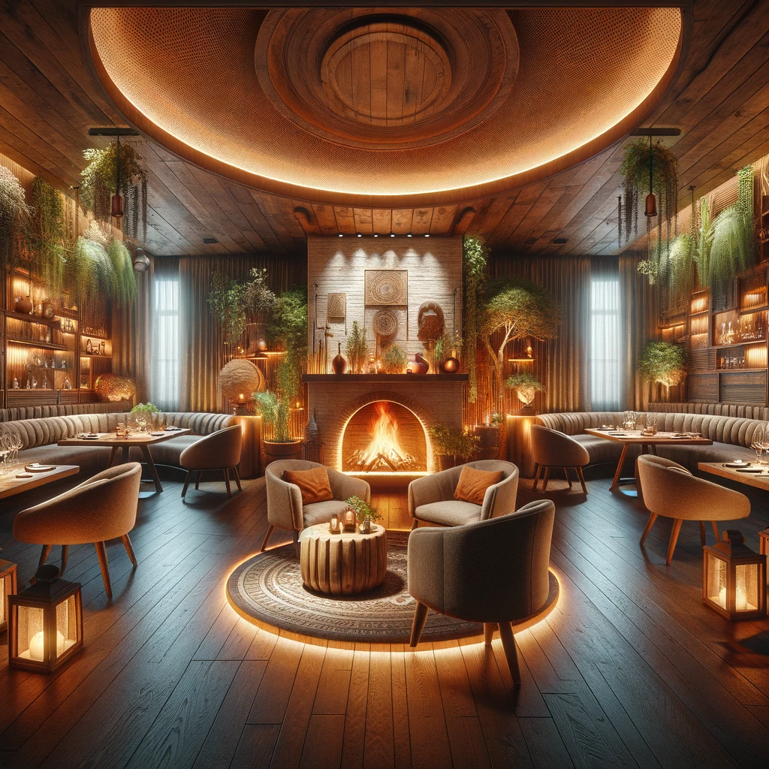
About Heaven Hearth
Heaven Hearth is a cozy restaurant that provides good entertainment and food. Whether you are going to get your fill or just want a cozy atmosphere, Heaven Hearth is the place for you! Our restaurant thrives on quality food but also quality environment by giving the consumer the best of the best afternoon and late night entertainment thanks to our incredible animatronics created and in collaboration with agreeing companies.

Slide 4
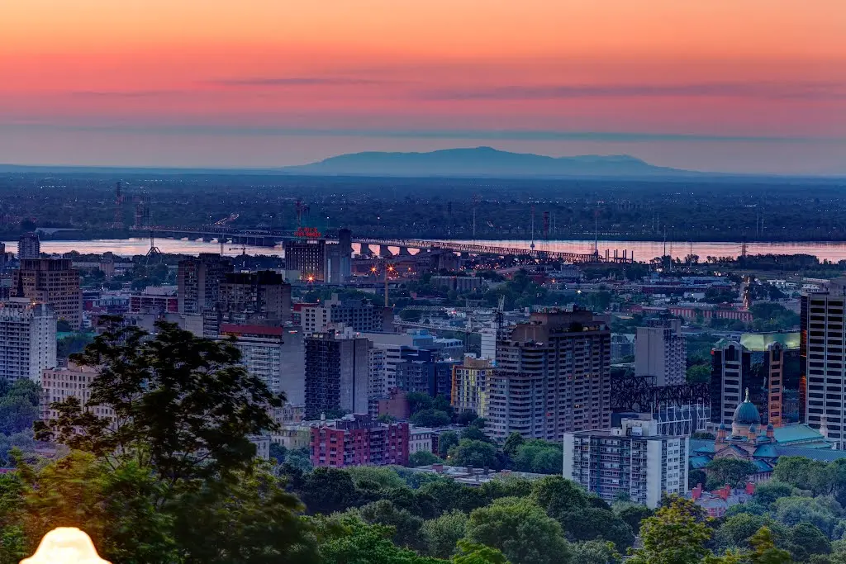
Scheduling
Days | Time
Monday | Closed
Tuesday | 8AM – 5PM
Wednesday | 8AM – 5PM
Thursday | 8AM – 10PM
Friday | 8AM – 12PM
Saturday | 8AM – 12PM
Sunday | 8AM – 12PM

Slide 5
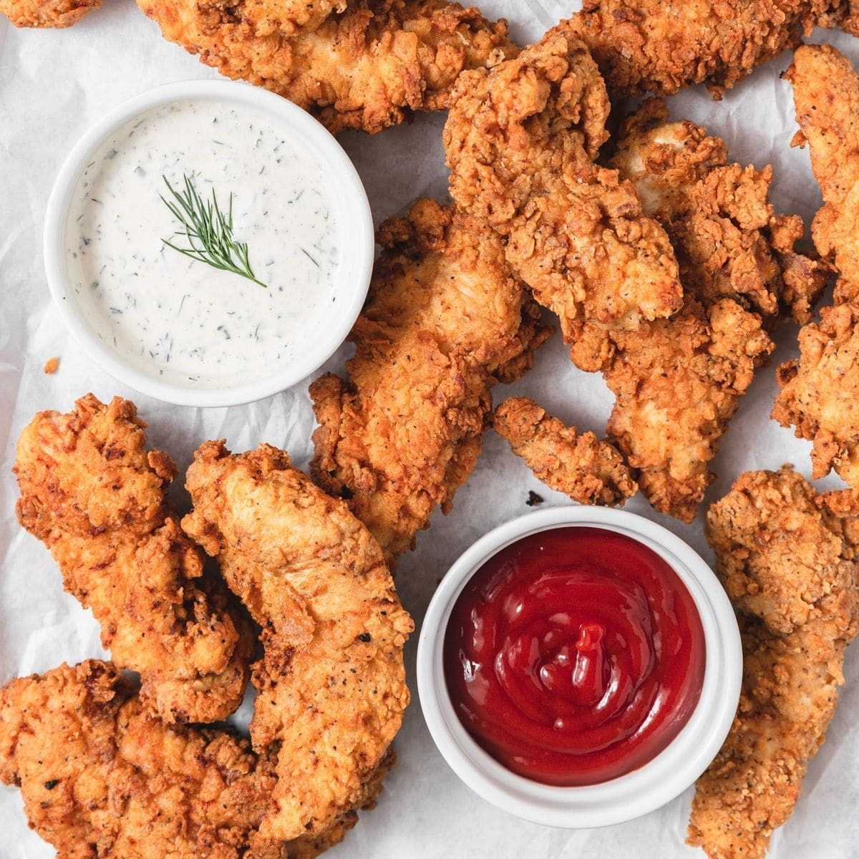
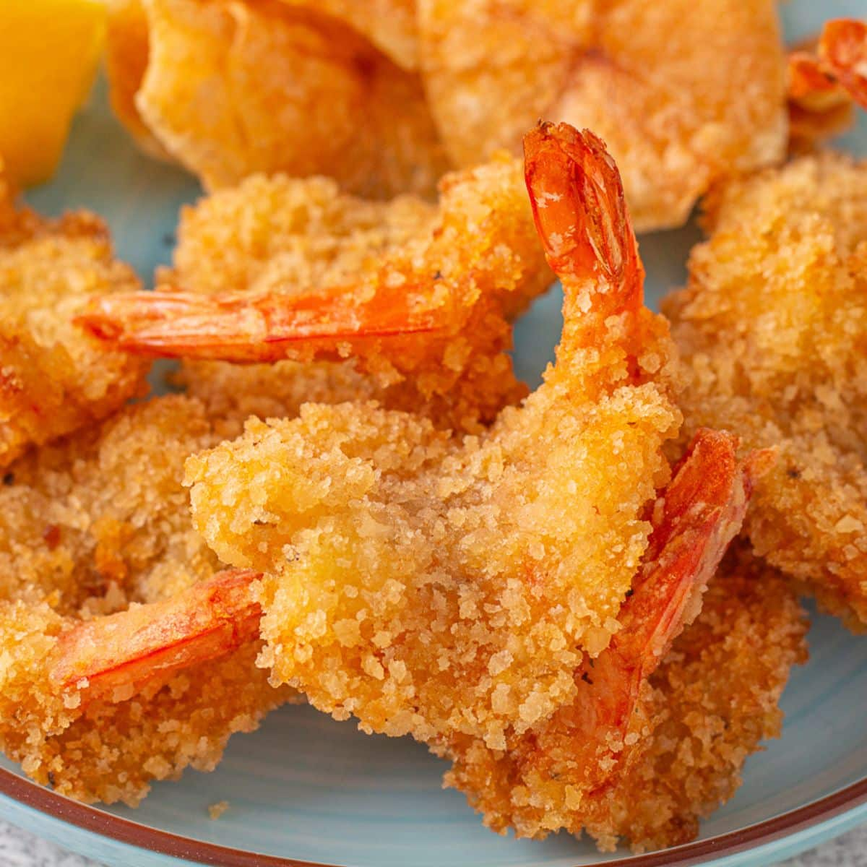
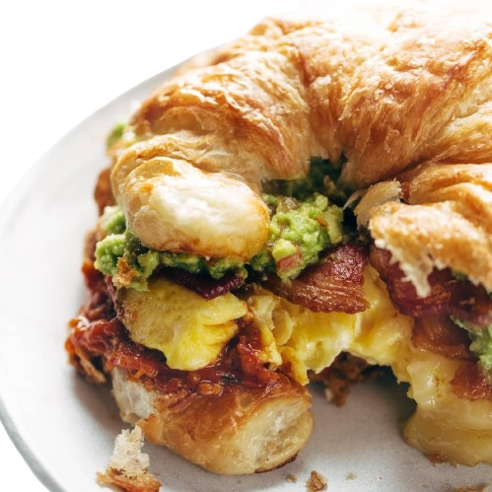
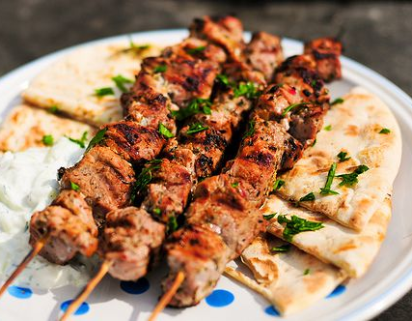
Menu
Separated in 7 groups:
Specials
Breakfast
Dinner
Supper
Kids Menu
Drinks
Desserts

Slide 6
Reservations
Number People | Prices
1-2 | 15$
3-5 | 20$
6-10 | 45$
11+ | 65$
Types of Seats | Prices
1-2 | No fee
3-5 | 15$
6-10 | 45$
11+ | 65$

Slide 7



Entertainers: Creators of atmosphere
Purpose: To bring atmosphere to the restaurant!
Entertainers: Animatronic-based (similar to a robot)
Name: Jigglypuff, Freddy Fazbear, Kass all bring something different to the atmosphere

Slide 8

Contact information: Help the user contact you!
Email: HeavenHearth@gmail.com
Phone Number: 438-501-0341
Find us at: 150 Saint-Catherine St W, Montreal, Quebec, H2X 3Y2
Instagram: @HeavenHarth

Slide 9

Website design

Slide 10
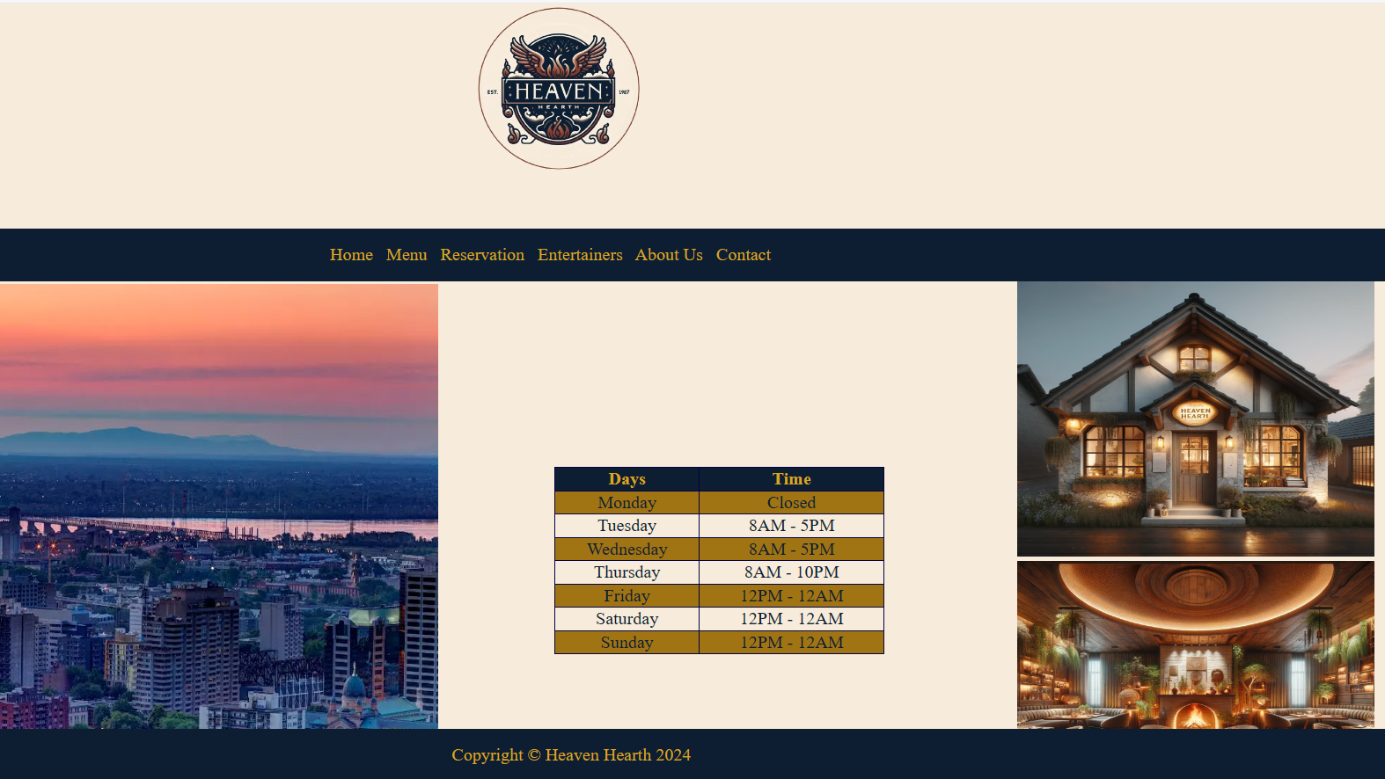
Homepage

Slide 11
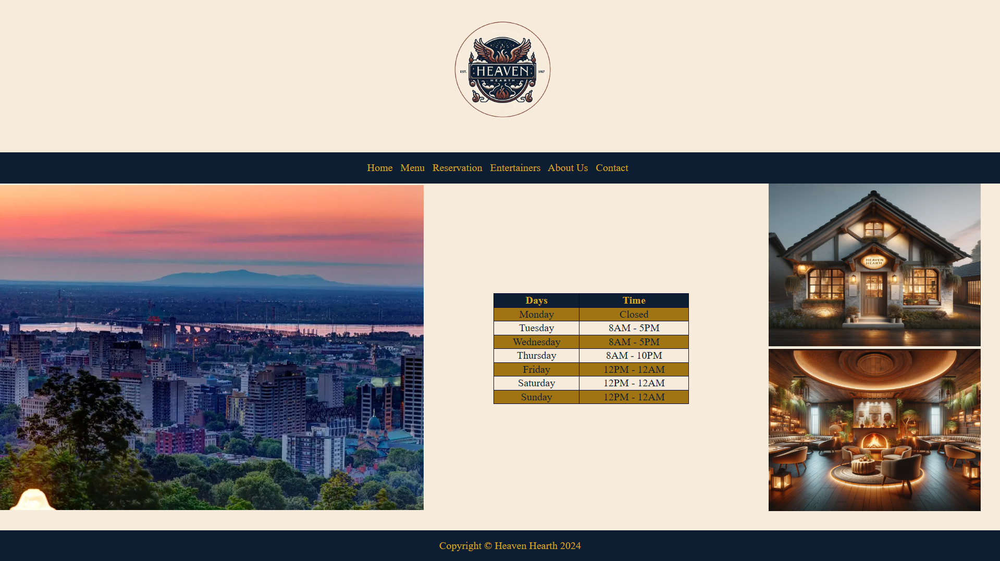
Menu page:

Slide 12
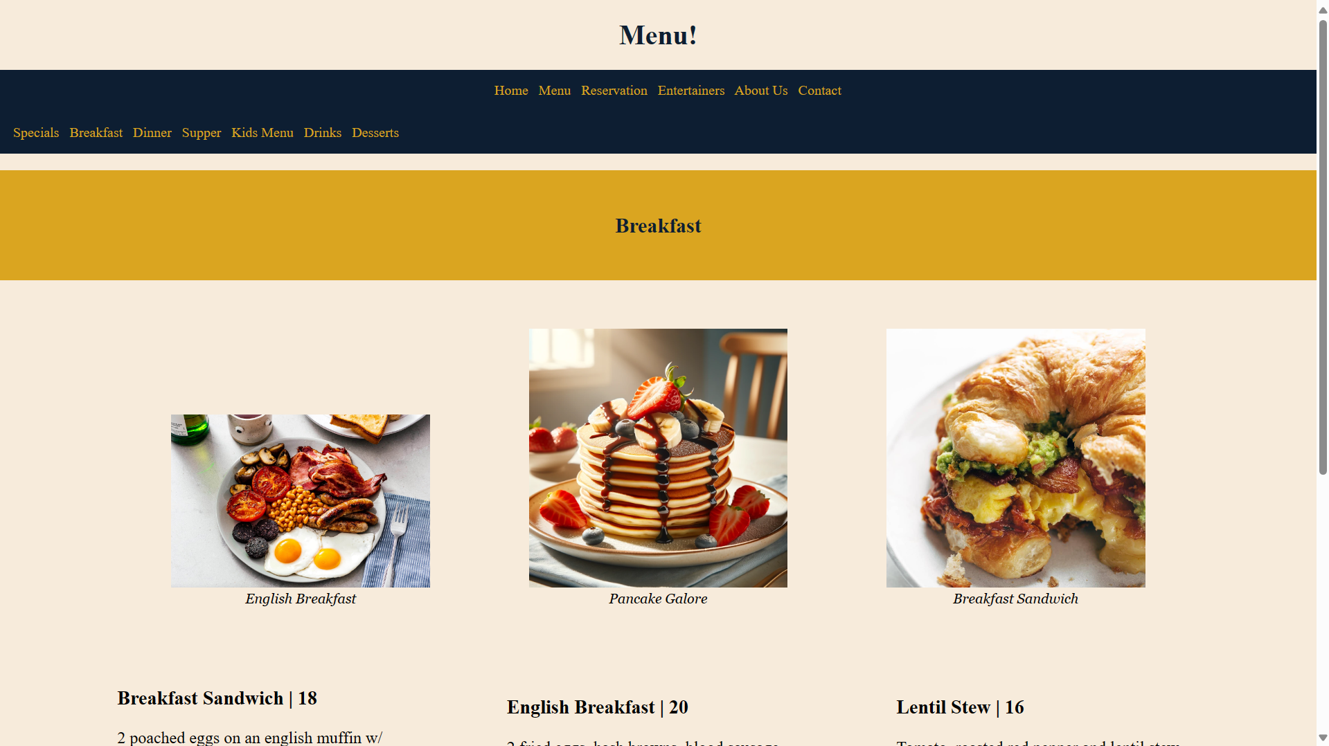
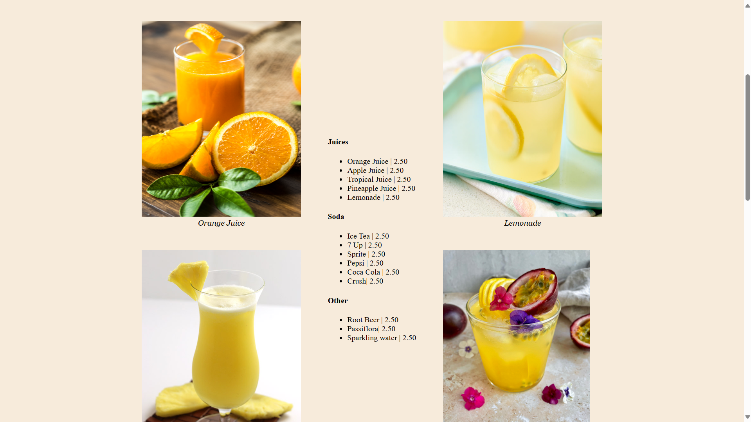
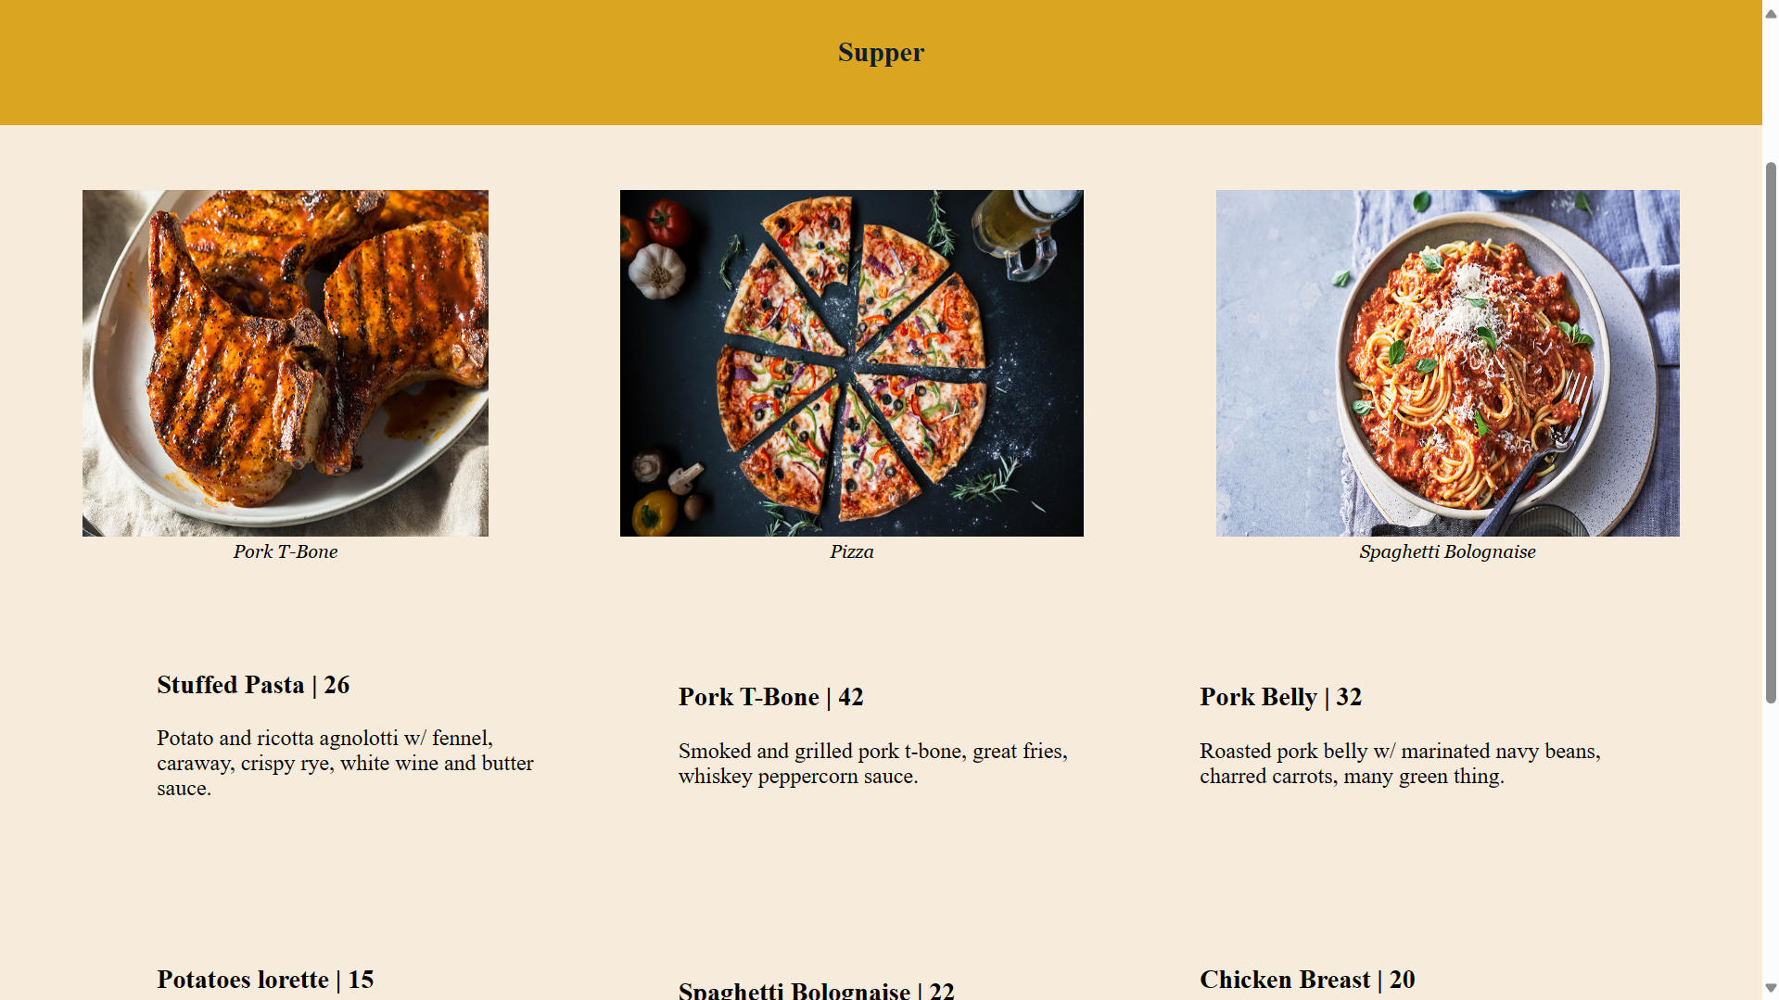
Menu (2)

Slide 13
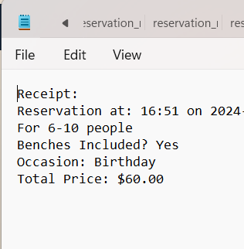
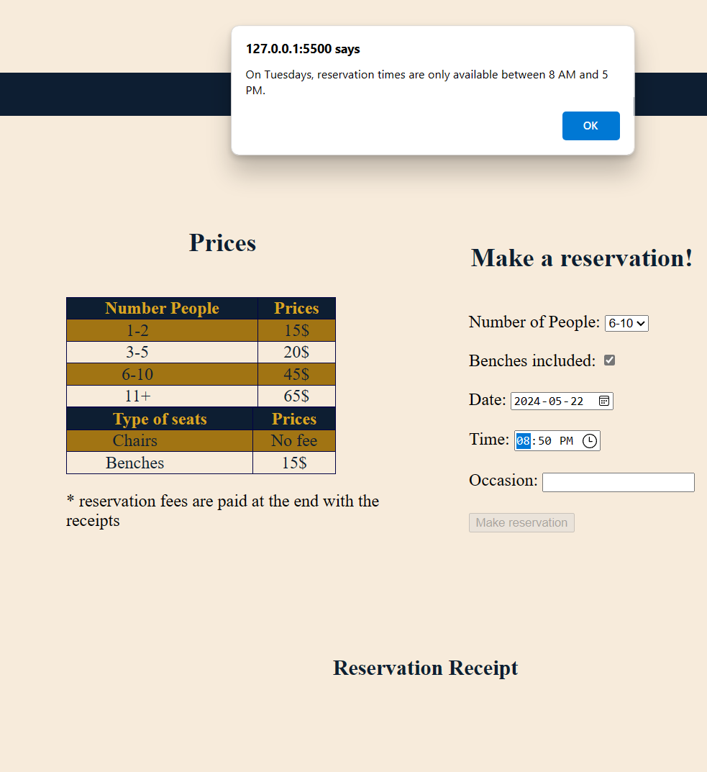
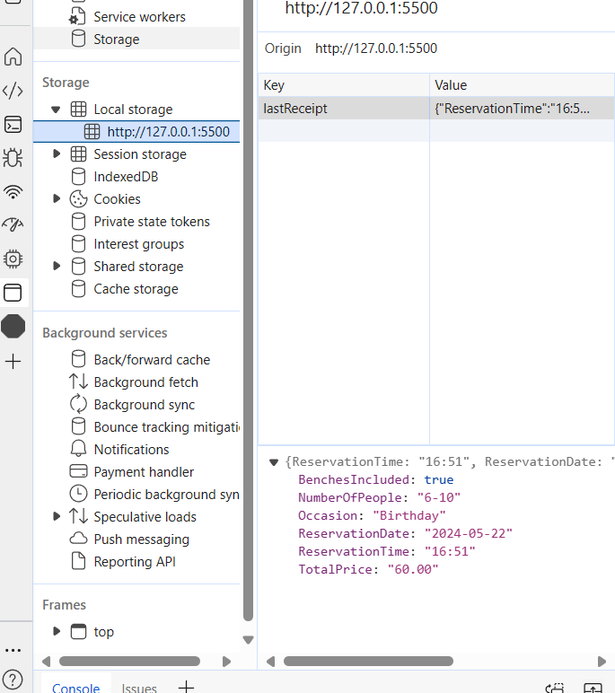

Reservation

Slide 14
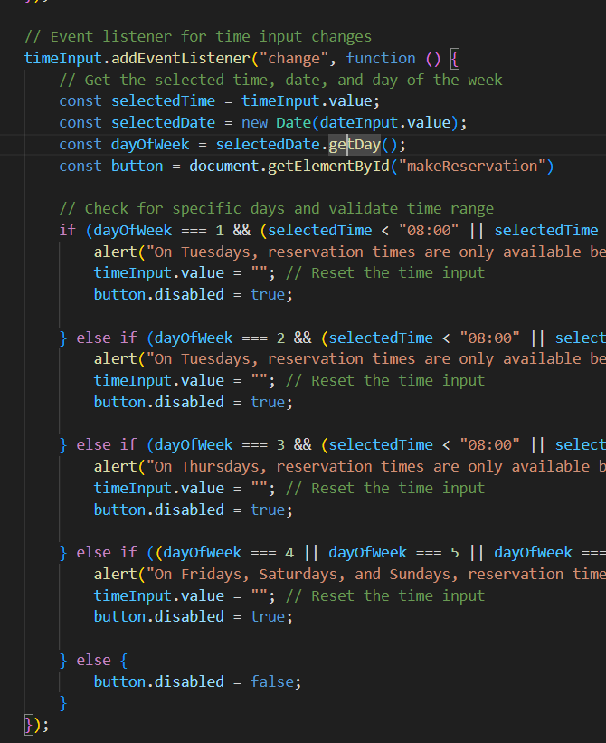
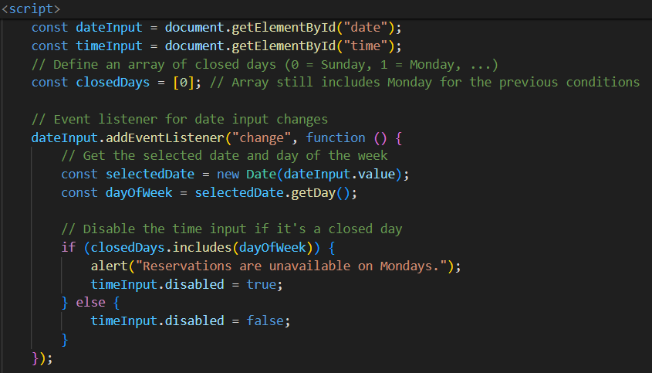
Code Usage for Scheduling
Makes sure that the user can’t reserve when the restaurant is closed.
dayOfWeek represents a value of a day (0-6). 0 is Monday while 6 is Saturday.
closedDays represents an array of days that are closed, in this situation, it’s only Monday

Slide 15
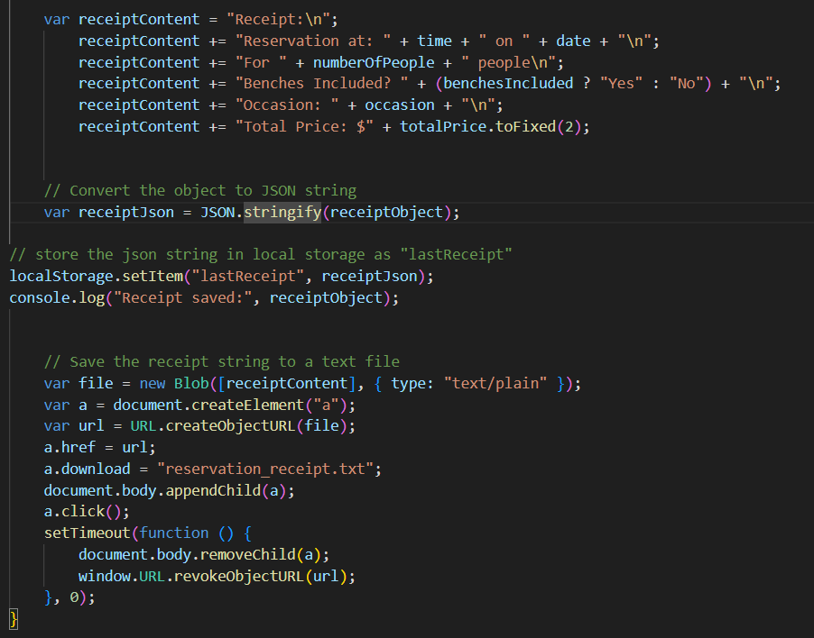
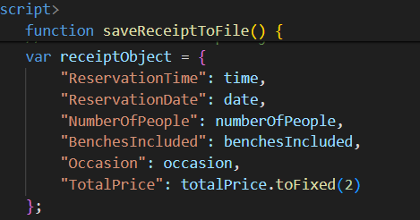
Reservation: Schedule creator
Variables are taken by the form submission if it is valid.
Two variables are created: receiptContent which will be converted to a textfile as receipt for the user. receiptIbject will be used to store in the local storage.

Slide 16
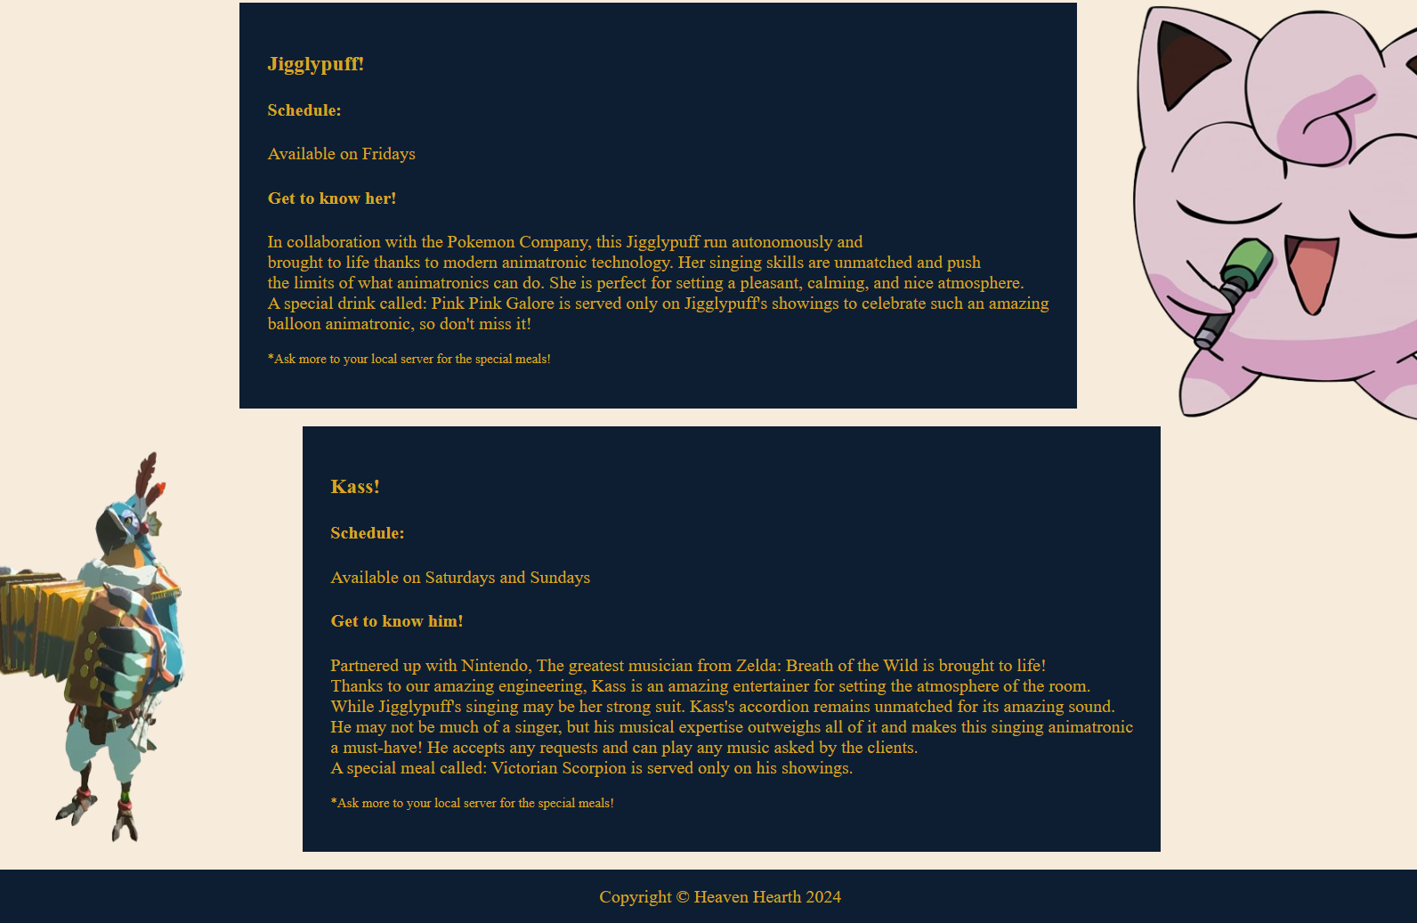
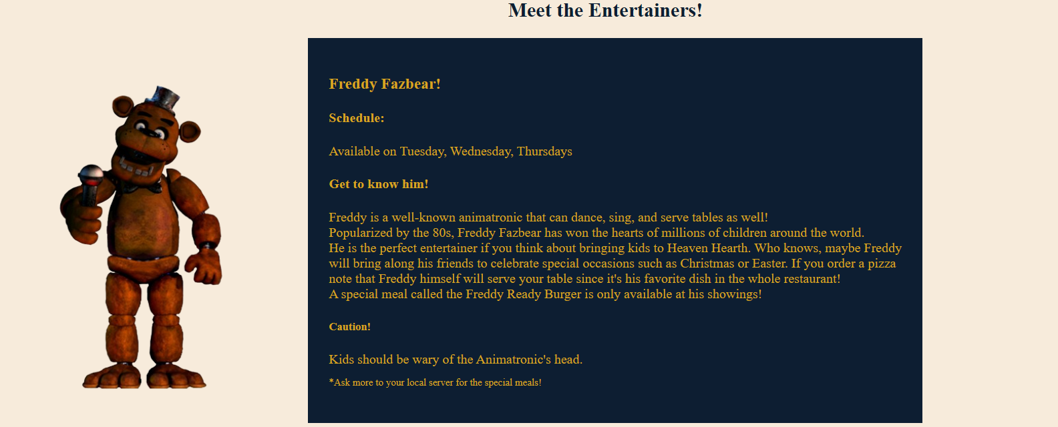
Entertainers
Each entertainer has its special meal attributed to them.
All legally created with no copyrighted problem whatsoever!

Slide 17
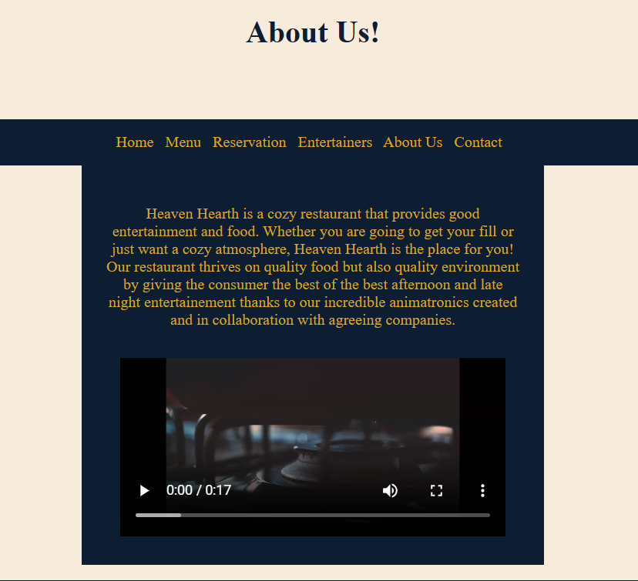
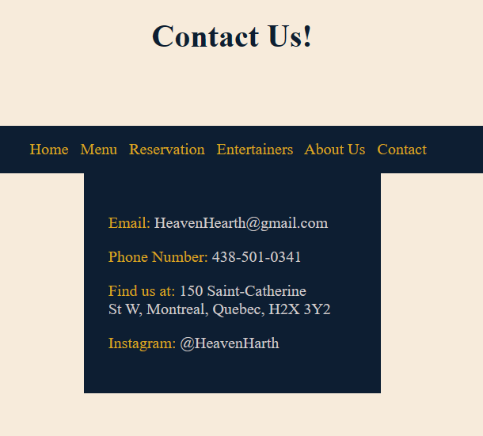
About Us and Contact

